Slide 1

Agile presentation
Donald Ingram

Slide 2
Scrum Roles
Product Owner
Scrum Master
Development Team
The Product owner is responsible for maximizing the value of the product and the work of the Development team. They are the sole person responsible for managing product backlog. They must clearly express the product backlog and order the items to achieve goals and missions.
The scrum master is a servant-leader role. They help the scrum team with clear and concise product backlog items, understand product planning and coaching the team in agile practices.
The dev team is responsible for creating a product at the end of each sprint. They create and test the product before release. There aren’t any sub teams everyone works together as one.

Slide 3


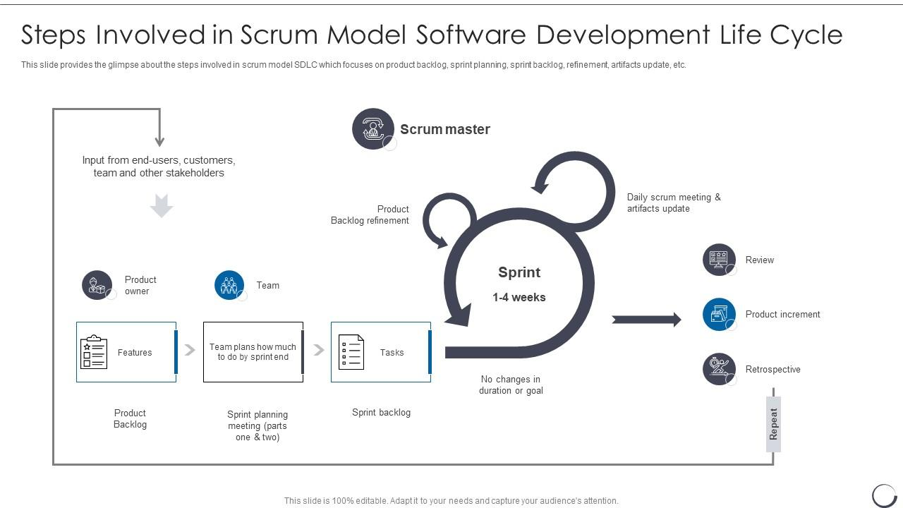
Phase 1
The products owner takes the input from the stakeholders and end users and creates the product backlog. This is a list of features and other details the end user is looking for in the product.

Slide 4
phase 2
The Dev team plans how much time they will need to complete the sprint and they delegate the tasks to among the members so that the project can be complete on time.

Slide 5
phase 3
This is where the sprint occurs. Here there are daily scrum meetings where the team communicates with one another. The actual development and testing goes on during this phase.

Slide 6
phase 4
Phase 4 is a sprint review. This is where the team shares the results of the sprint with the product owner to see if it is acceptable. The retrospective also happens here. This is where the team discusses lessons learned. They reflect on the what went well and what didn’t. then the cycle starts over for the next sprint or the finished product is released.

Slide 7
Waterfall Development
The Waterfall method is a liner and sequential method. Once a phase of development is completed there is no turning back, like water in a waterfall. For this travel project this method wouldn’t have worked because in the middle of the sprint the product owner received new requirements which meant we had to go back and edit the already completed sprint. Since we used agile this was not a big issue for the team. The flexibility and adaptiveness of agile helped with the travel project because as we learned we were able to build and add to the project.

Slide 8
Refrences
The Project Manager's Guide to Mastering Agile : Principles and Practices for an Adaptive Approach; Author : Charles G. Cobb 2015
www.slideteam.net (diagram on slide 3-6)

